Slide 1
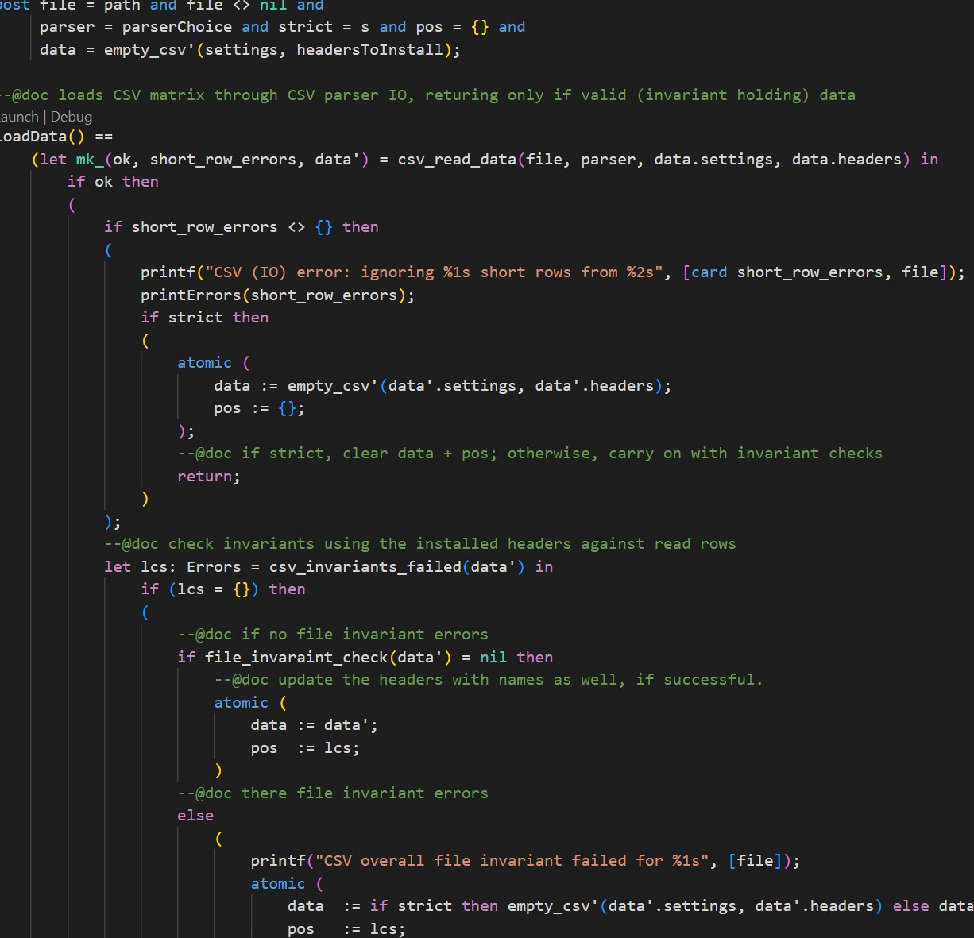

Specification-based CSV Support in VDM
The 21st Overture Workshop
10th March 2023
Leo Freitas¹
Aaron John Buhagiar²
1. School of Computing, Newcastle University
2. Translational and Clinical Research Institute, Newcastle University

Slide 2


Introduction
Simple format for data exchange
Ubiquitous use in a myriad of domains
Data science applications
Medical
Payments
Many variations and versions are used
Current version distributed with VDM is limited
A new CSV library with improved
Validation
Ease-of-use
Performance

Slide 3
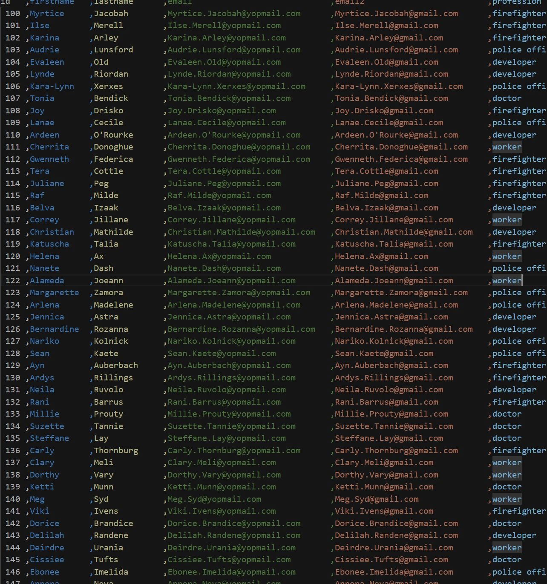
Standard VDM CSV Library
Slow and error-prone
Line-by-line parsing in VDM
Strict and limited format
Only IO native calls available
Imported data is of a wildcard type

Slide 4
Design Principles
S
A
F
E
imple
ccurate
ast
ffective

Slide 5
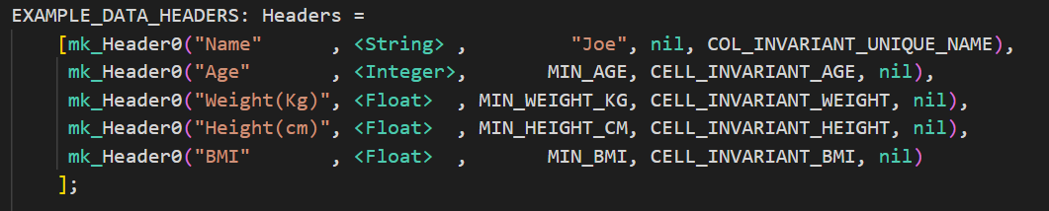
Setup
Strong CSV typing is captured through semantic headers
Column Name
Datatype
Default Value
Cell invariants
Column Invariants
Settings define file properties
Presence of blank lines
Existence of a header row
Comment string

Slide 6
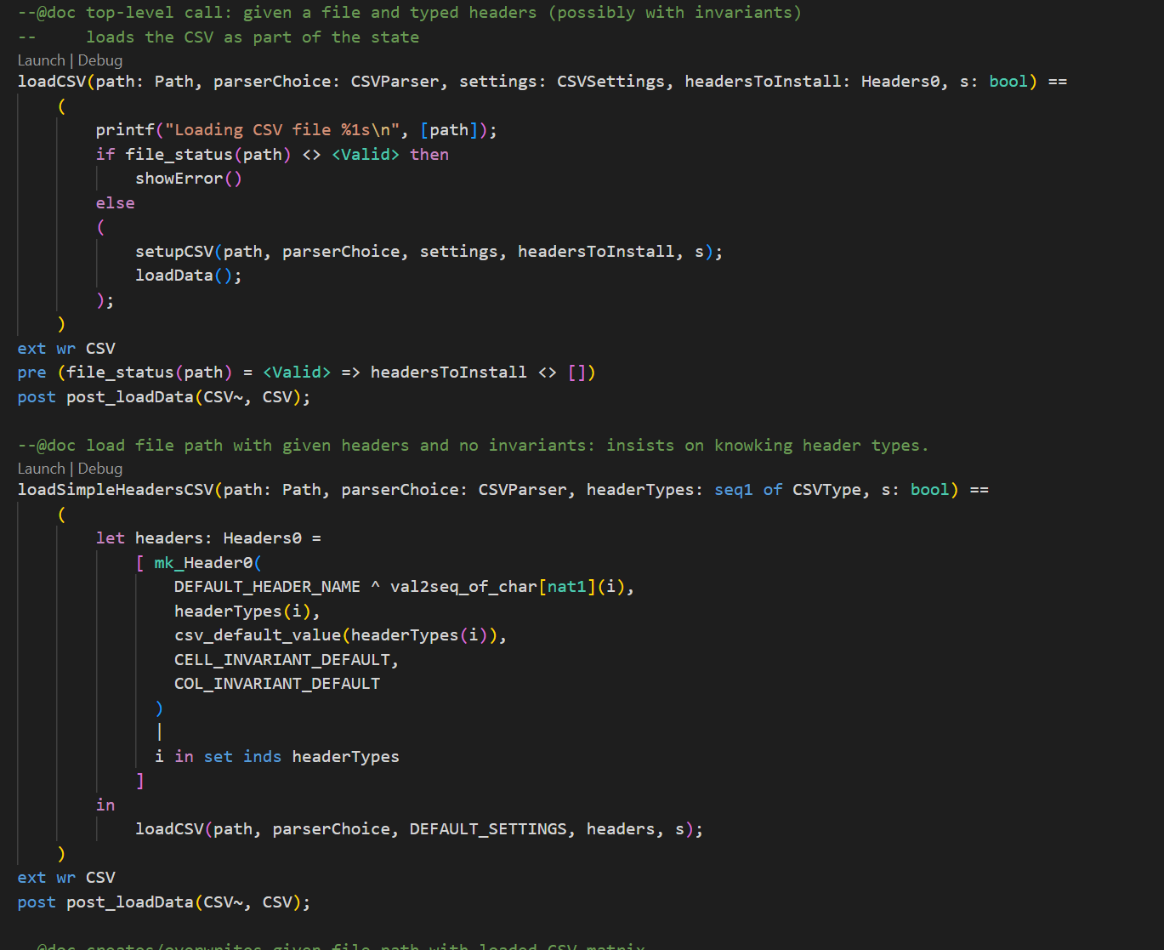
Simple: Ease of Use
Accessible entry points that abstract from the IO native calls
Out of the box setup
Configurable
Allows direct native calls for better extensibility
1
2

Slide 7
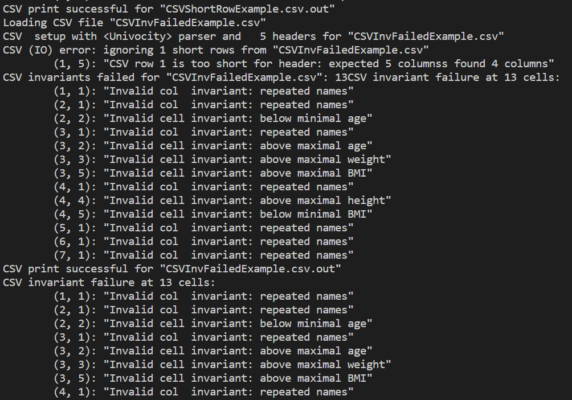
Simple: Reporting
Simple and descriptive reporting capabilities
Short rows
Implicit type invariant violation
Custom invariant violations
Provides direct cell locations for correction
Striving to have a strongly-typed CSV

Slide 8




Accurate
Implicit checks on data imported
Short rows
Type validation
Custom invariants
Cell invariants
Column invariants
Row invariants
File Invariants
Invariants return a Reason
1
2
3
4
Notes:
Important to explain the nature of the type signature and how it works
What’s a reason and how one encodes success / failure etc.

Slide 9
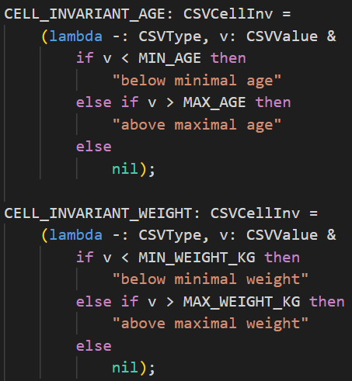
Accurate: Cell Invariant
Invariants that act upon cells directly
Embedded with the header
Examples
Upper/Lower bounds
Text validation
Specific value enforcement
etc…

Slide 10
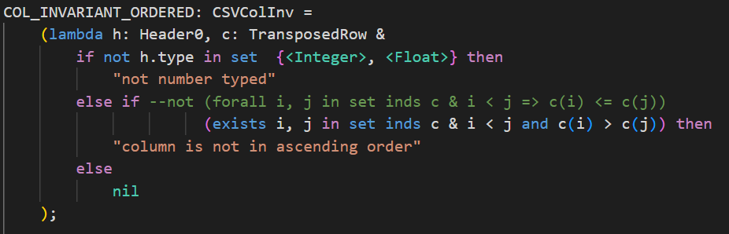
Accurate: Column Invariant
Work across a single column in the CSV
Embedded with the header
Example
Uniqueness
Dependence

Slide 11
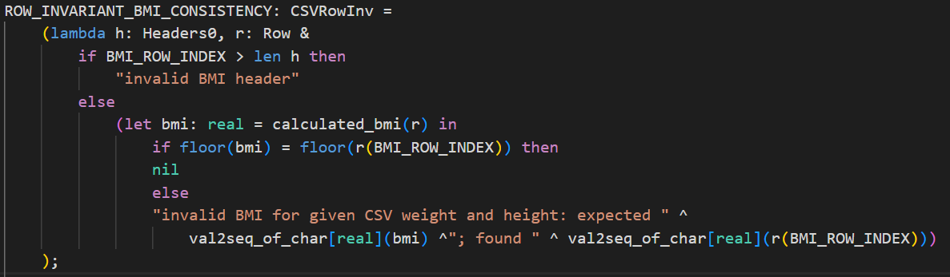
Accurate: Row Invariant
Row-wide invariant
Allows for more complex data validation
Examples
Consistency
Dependence
Redundance

Slide 12
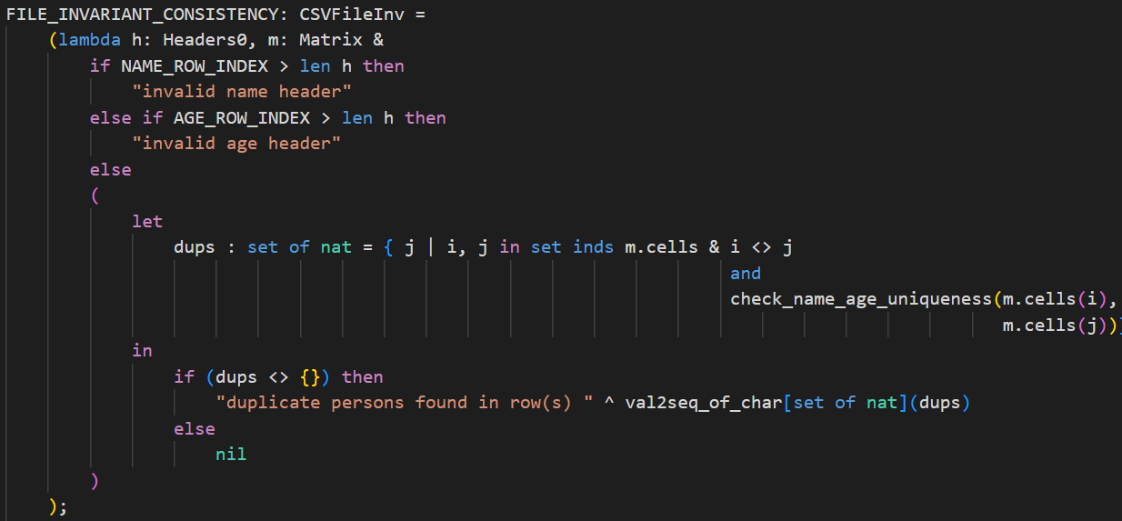
Accurate: File Invariant
Invariant over all the CSV data
Example
Dependence
Redundancy

Slide 13
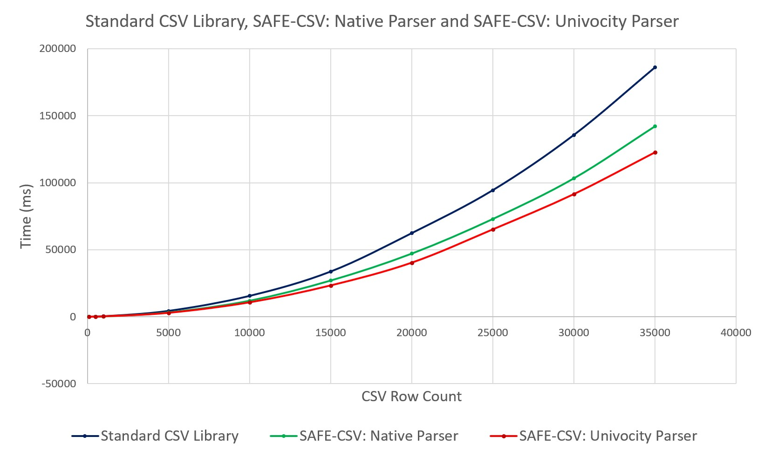
Fast

Slide 14
Effective
Multiple CSV format variants
Better tolerance to file format variability
Delegate CSV format to parsers (e.g. formalisation of CSV format itself)
Ease of use
Improved error handling and reporting
Better validation
Faster performance

Slide 15
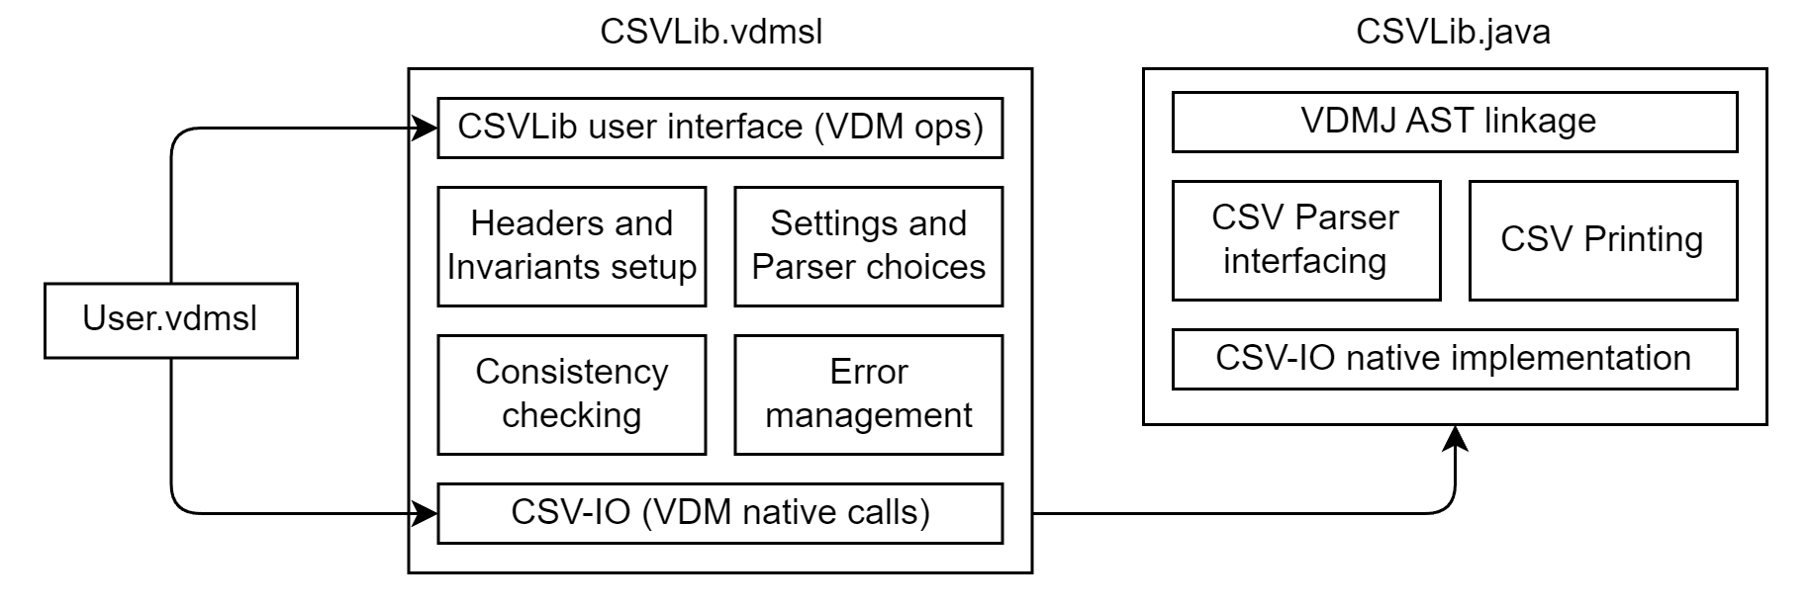
Library Architecture

Slide 16
Future Work
Implementation of debugging environment
Improved variety of CSV formats
Nested CSVs
More CSV data types
Multiple CSV headers per file

Slide 17
Thanks for Listening

